Slide 1
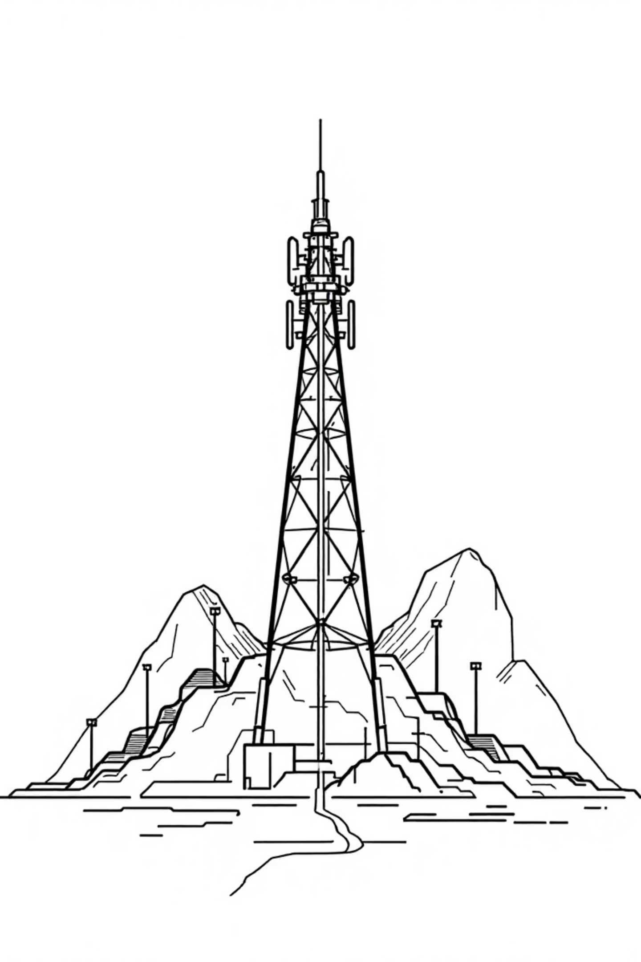
Auto EA-SORAN: AI-Native Energy Optimisation for 5G RAN
How it works: A Simu5G digital twin feeds a Python multi-agent loop (Prediction → Optimisation → Feedback → Orchestration) over ZeroMQ/CSV files to reduce base-station energy while keeping QoS within policy.
Team NoWiresAttached

Slide 2

The Challenge: RAN Power Consumption
Dominant energy bills:
1
5G's capacity boost inflates RAN power use, dominating operator energy expenses.
Idle waste:
2
Even with minimal traffic, many base station (BS) components remain active, wasting energy.
Inflexible rules:
3
Static settings fail to adapt to dynamic traffic and varying service level agreements (SLAs) like eMBB, URLLC, and mMTC.
The Goal: Develop a safe, automated system to adjust BS settings based on real-time demand—without compromising Quality of Service (QoS).

Slide 3
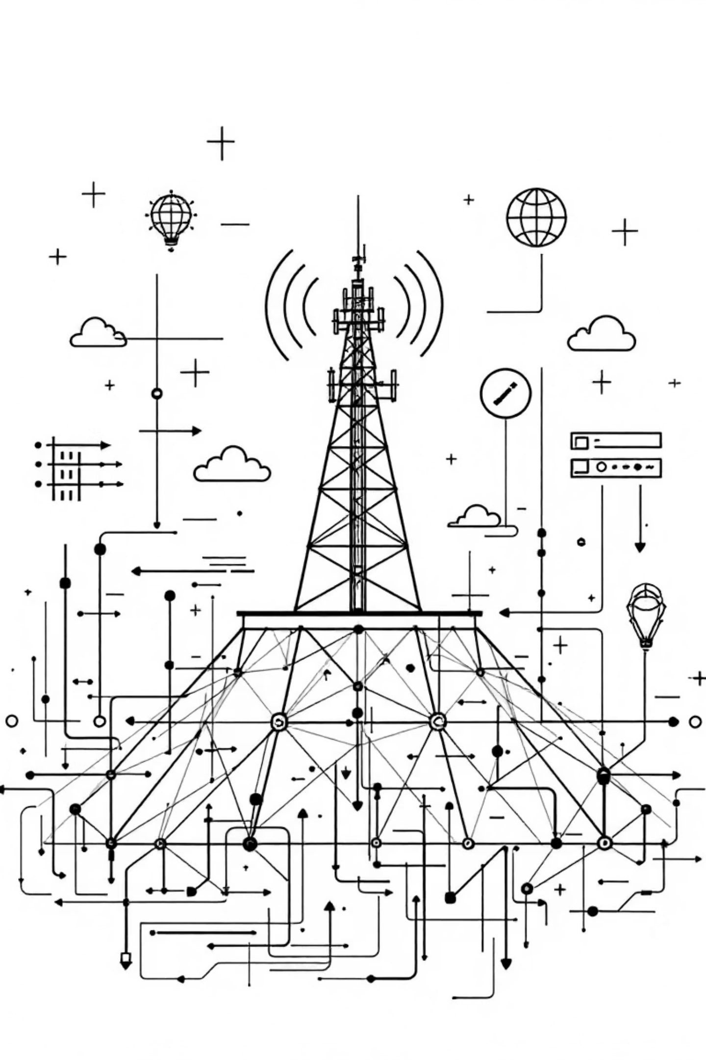
Why Is Energy Optimisation Difficult?
Complex Dependencies: Base station energy use hinges on configuration (TX power, carriers, bandwidth), traffic (PRB utilisation), and energy-saving (ES) modes (micro/deep sleep).
QoS Risks: Blindly adjusting settings can negatively impact throughput and latency.
We require a closed-loop system that predicts, optimises under policies, and verifies safety before implementing any changes.

Slide 4


Our Solution: AI-Powered Optimization Loop
Digital Twin:
Leverage Simu5G to monitor KPIs and simulate actions on gNodeBs.
Four Python Agents (ZeroMQ):
Prediction: Utilises a Keras ANN for short-term energy forecasting.
Optimization: Proposes energy-saving strategies.
Feedback: Ensures proposed plans align with established policies and thresholds.
Orchestration: Implements approved modifications within the Simu5G environment.
Goal: Reduce energy consumption while maintaining QoS within defined parameters.

Slide 5
Integration within the 5G Service Landscape
Our optimisation techniques adapt based on the specific service type, ensuring tailored energy savings.
eMBB (Enhanced Mobile Broadband)
URLLC (Ultra-Reliable Low Latency Communications)
mMTC (Massive Machine Type Communications)
Prioritise throughput efficiency.
Focus on minimal latency and loss.
Cater to sparse traffic scenarios.
Employ micro-sleep and subtle TX-power adjustments.
Employ conservative strategies.
Utilise deeper sleep states and carrier off windows.
Maintain at least p95 DL rate.
Implement immediate rollback for violations.
Employ broader operational thresholds.
Policy-driven optimisation: Policies adapt savings to service needs.

Slide 6


Deployment Pathways for Real-World Networks
O-RAN Integration
Simu5G Validation
Deploy Prediction/Optimisation/Feedback as near-RT RIC xApps. Orchestrate actions via E2 interface to gNBs; monitor KPIs via SMO/OAM framework.
Utilise Simu5G for high-fidelity testing. Train and validate policies and actions safely before real-world pilots.
Benefit: Provides a safe, controlled environment for testing and refining energy optimisation strategies.

Slide 7



Core Operational Dynamics
Key Elements
Dynamic Loop
ZeroMQ Advantage
gNodeB (BS), PRB utilisation, TX power, carriers, bandwidth, ES modes (micro/deep sleep) are optimised.
Real-time BS metrics → Prediction (estimate energy use) → Optimisation (select action) → Feedback (policy enforcement/rollback) → Orchestration (apply changes).
Enables low-latency, straightforward Python↔C++ communications.

Slide 8

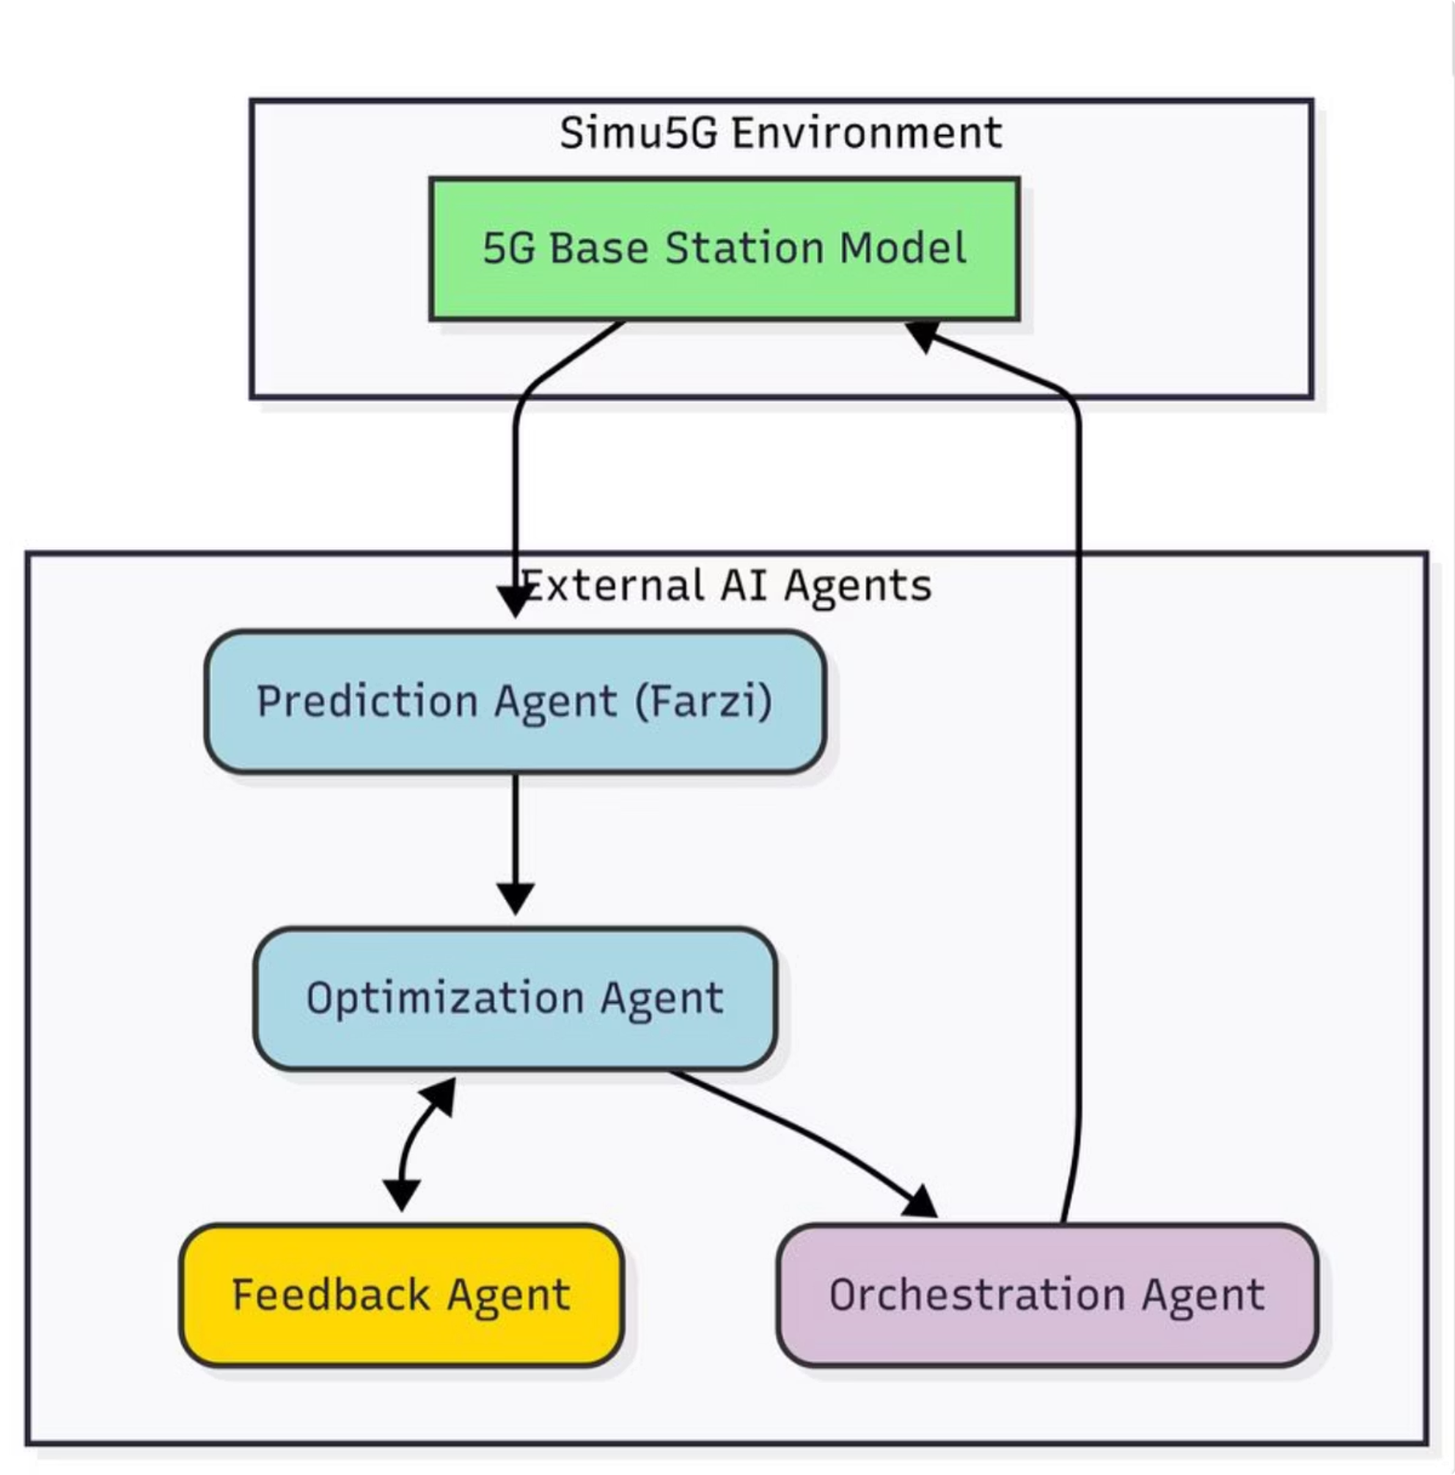
System Architecture Overview

Slide 9
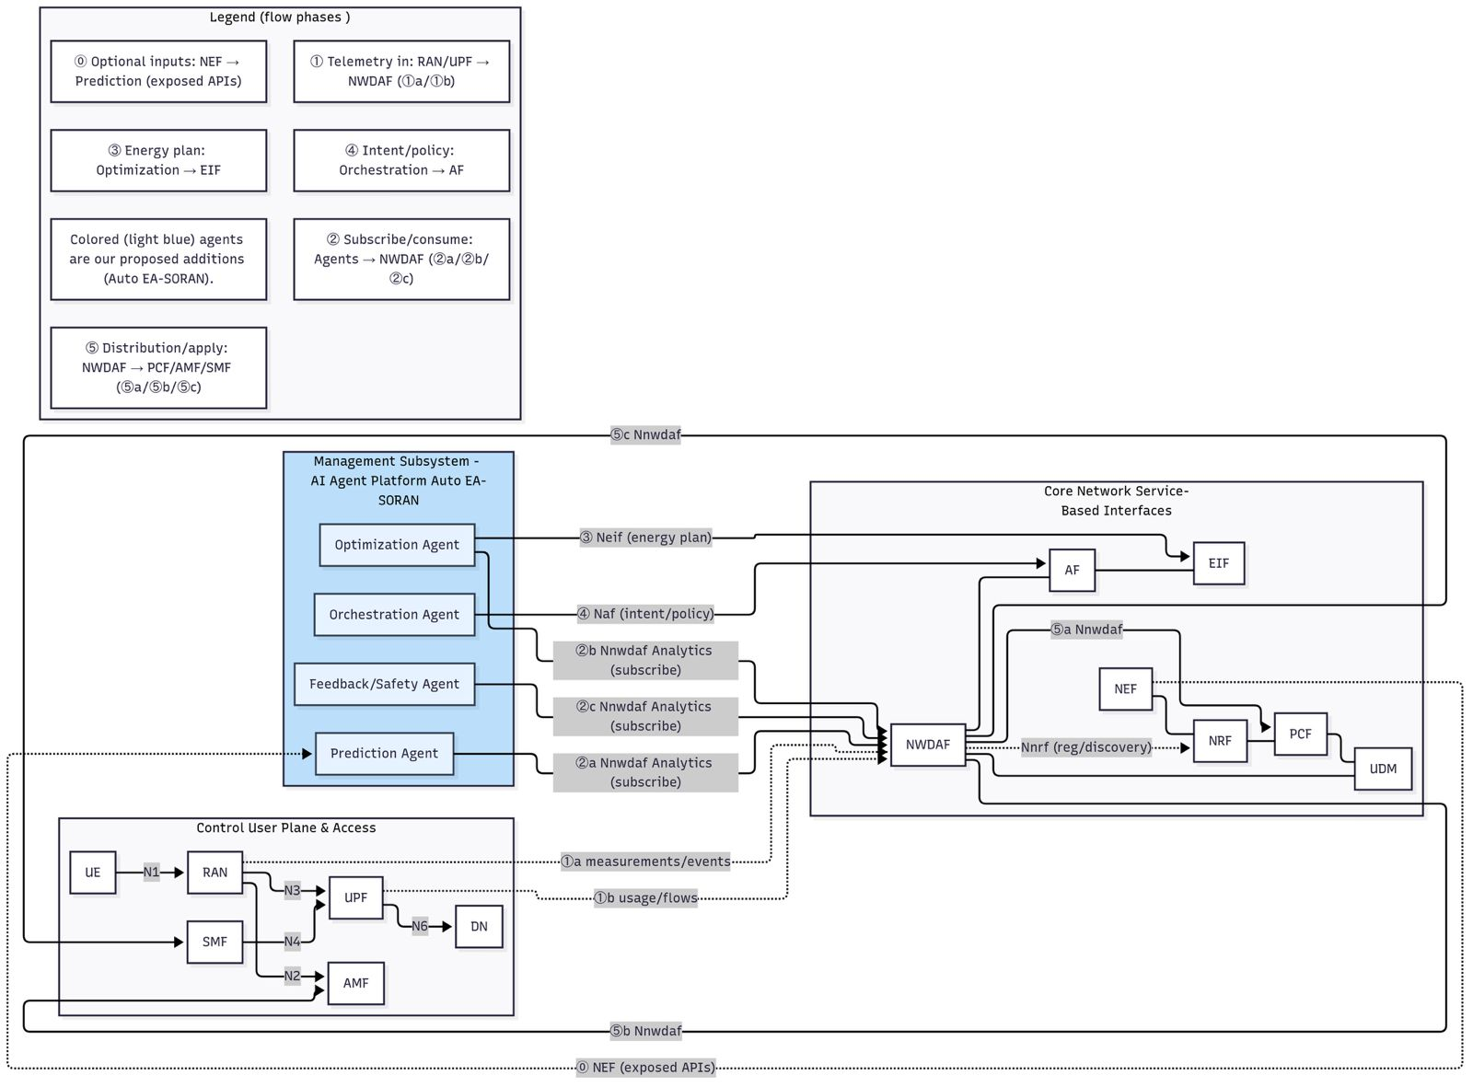

Slide 10

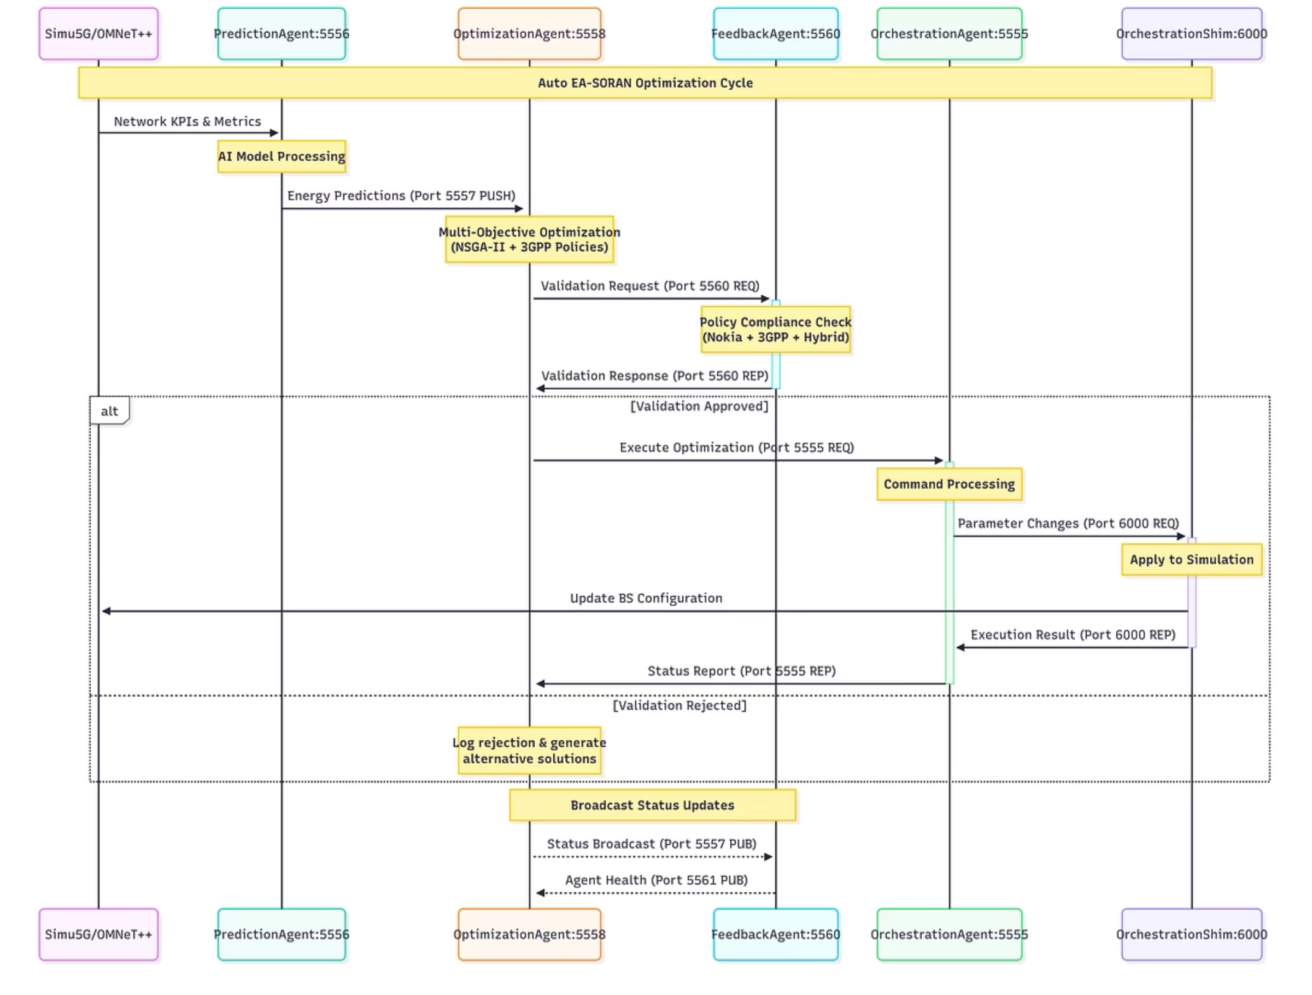
Detailed Sequence of Operations

Slide 11
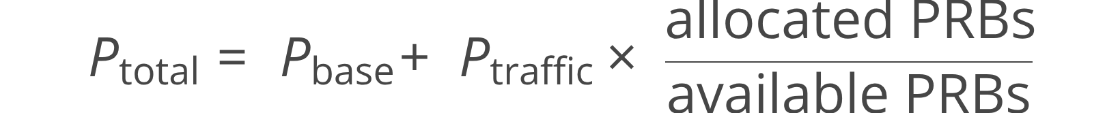
Deciphering Energy Conservation Metrics
Power (W): Measures instantaneous energy consumption.
We integrate power over a given period to determine energy consumption and benchmark against baseline results.
Energy (J or Wh/kWh): Represents power use over time.
Result Presentation:
Simu5G Integration: Provides power states (active, micro, deep) and a power formula related to PRB utilisation:
% Energy Saved = (Ebaseline - Eoptimised)/Ebseline x 100%
Absolute kWh saved for the specified duration.

Slide 12
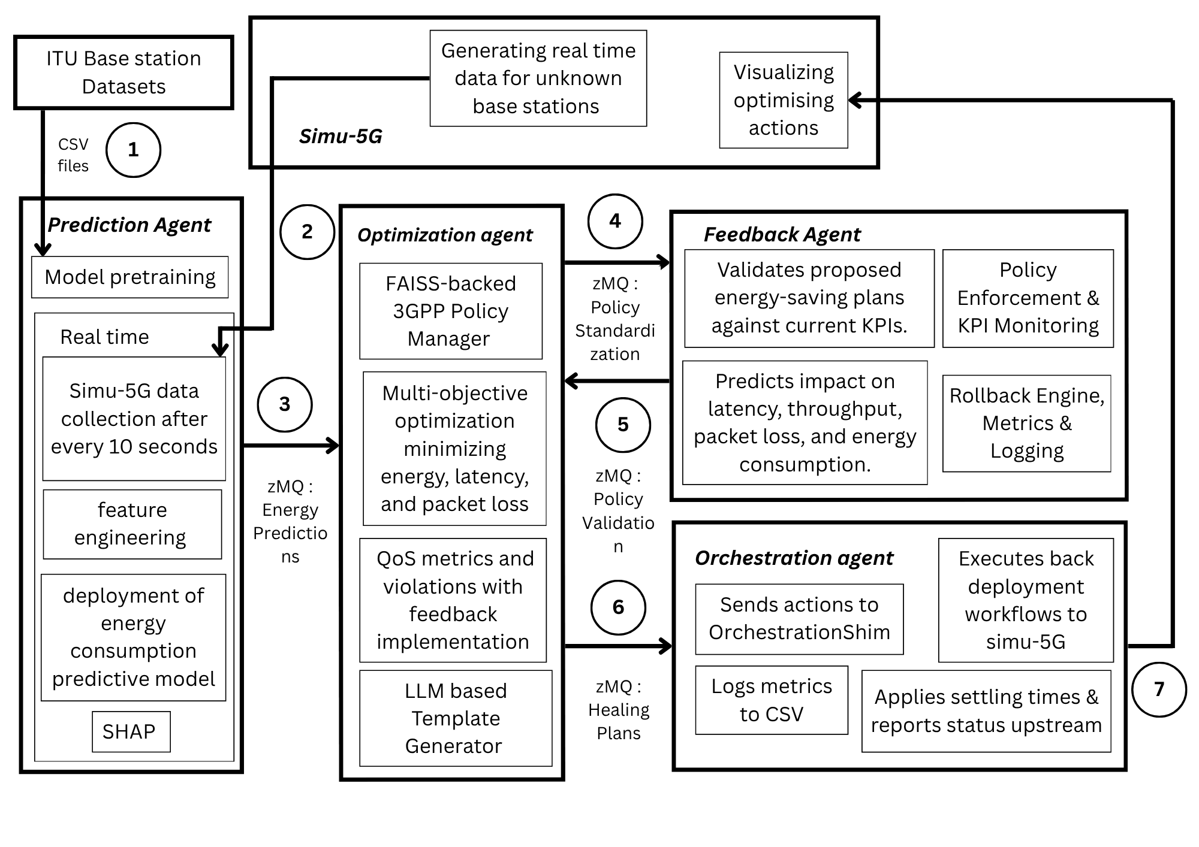

Slide 13
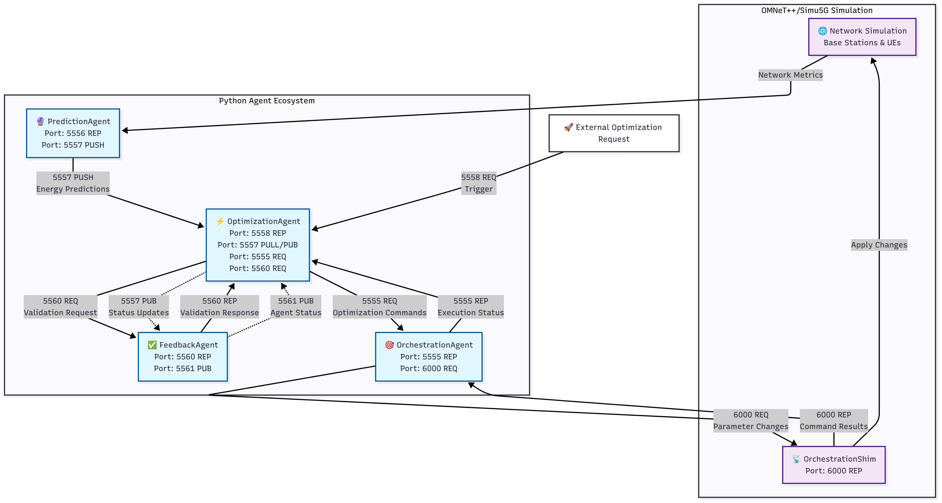

Slide 14
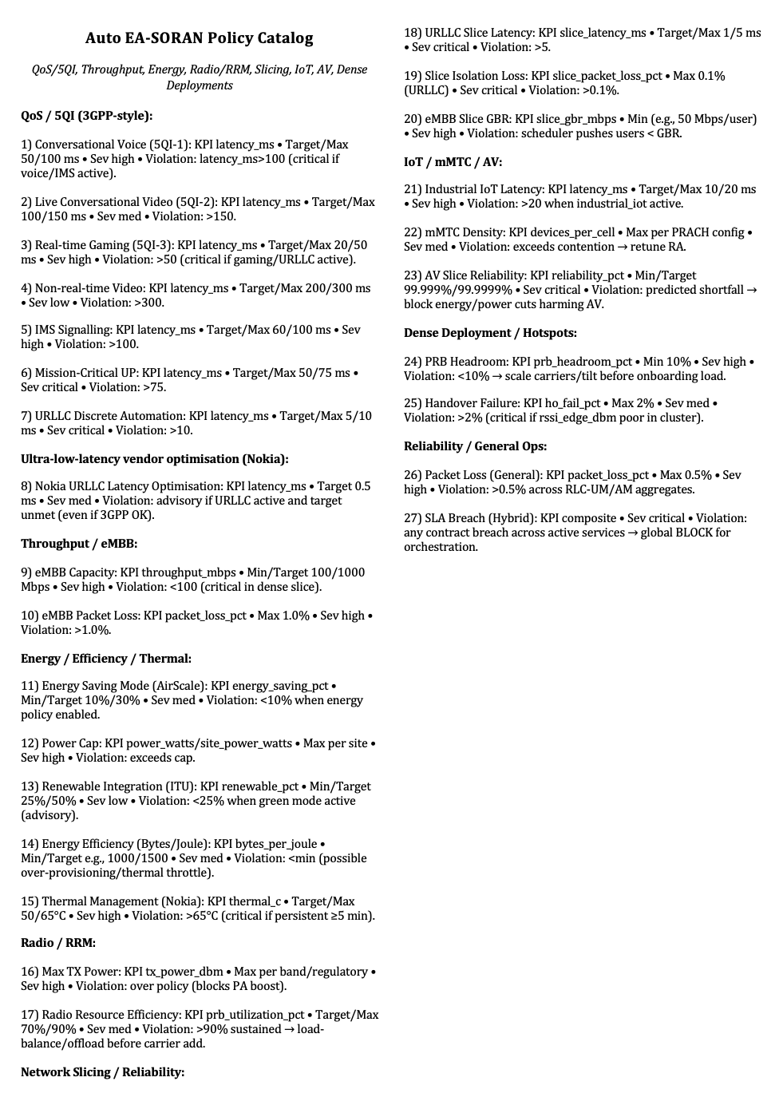

Slide 15
OUTPUT & CONCLUSION

Slide 16
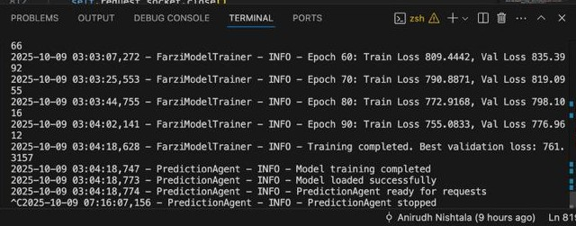
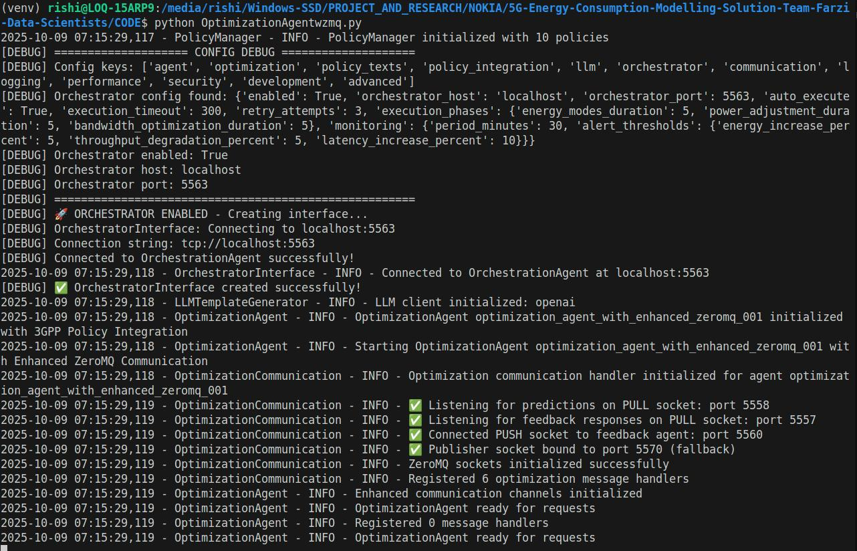
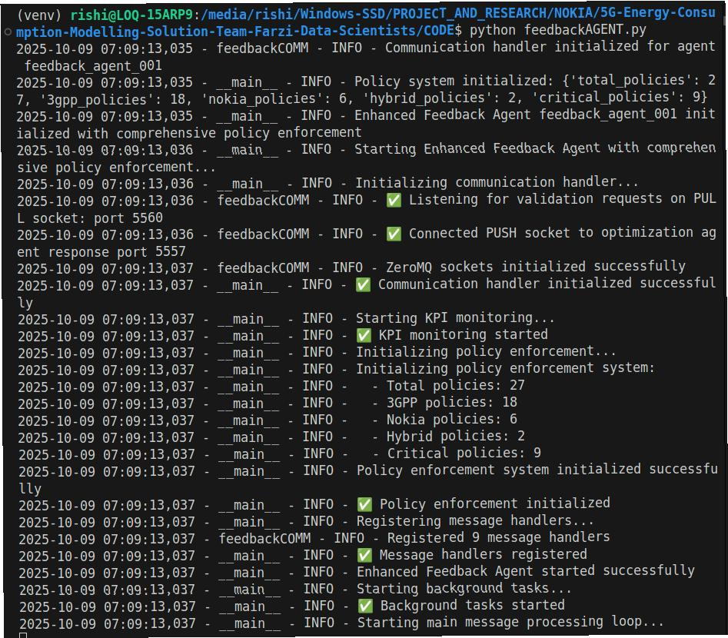
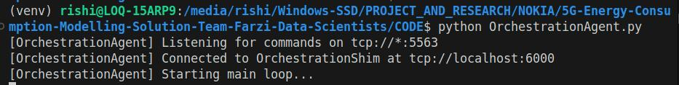
Output screenshots

Slide 17
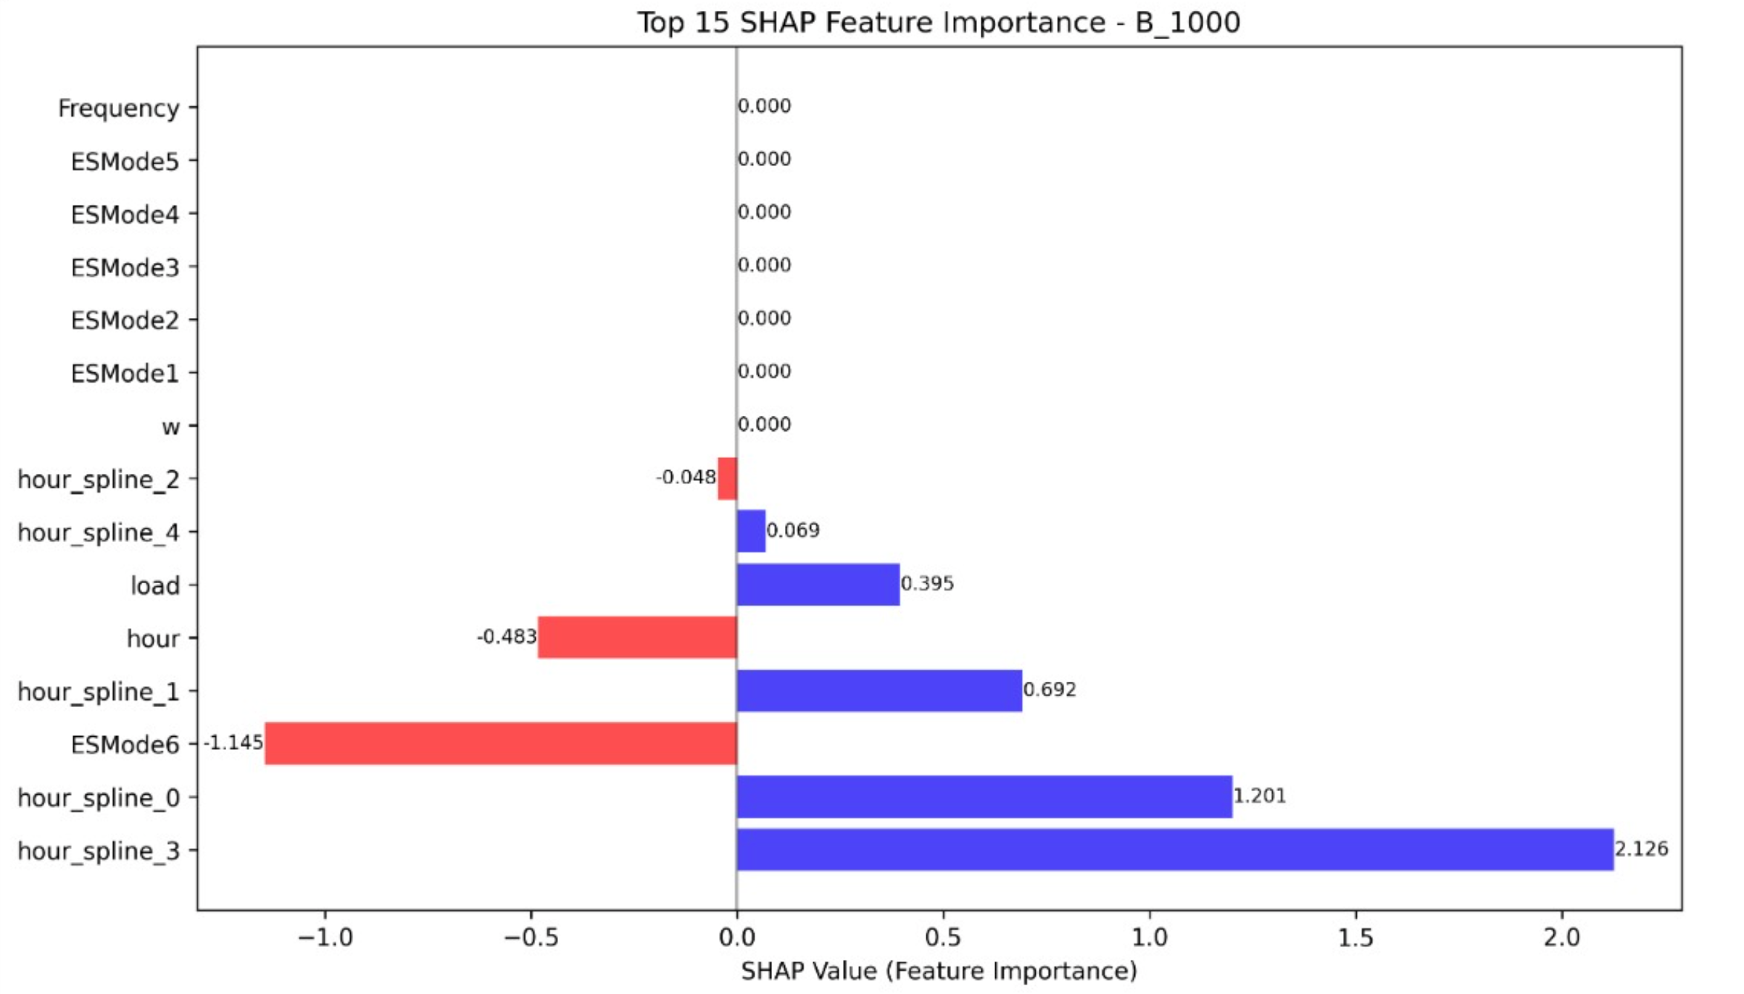
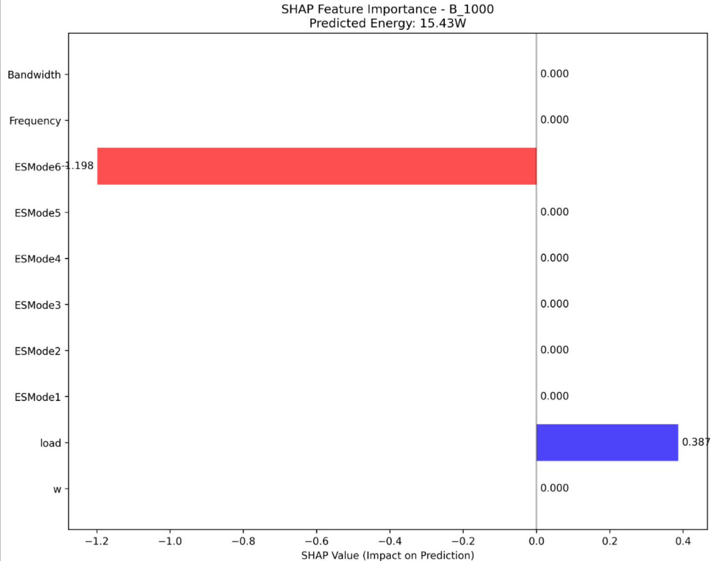
THE SHAP GRAPHS

Slide 18
THANK YOU!

